Slide 1

Railway Reservation System
BRACT’s
Vishwakarma Institute of Information Technology
Department of Information Technology
Name: Ayush gupta
Roll no.: 333004
GR no.: 22011191
Name: VRUSHABH CHUDIWAL
Roll no.: 333011
GR no.: 22011174

Slide 2
Introduction
The idea and introduction of the App is very good, but the execution is extremely flawed in almost every step.
With such a fast-paced life, people don’t have the time to stand in queues for tickets, neither do they have time to spend more than a minute to book a ticket on an App.
The problem:
Slow and difficult usability.
The features are inadequate and a few are missing.
Old and outdated visual design.

Slide 3
The Solution
Shedding light on the issues mentioned in previous slide, a redesign of the entire in-app experience was required. Three main goals were defined:
Improve the UX design, creating a smoother user flow between the core functions of the application like ticket booking and payment interface.
Implement additional features that allow innovation, ease the user experience and boost the sales of tickets.
Completely redesign and define a new visual appearance of the interface to keep it at par with the modern day smartphone application.

Slide 4
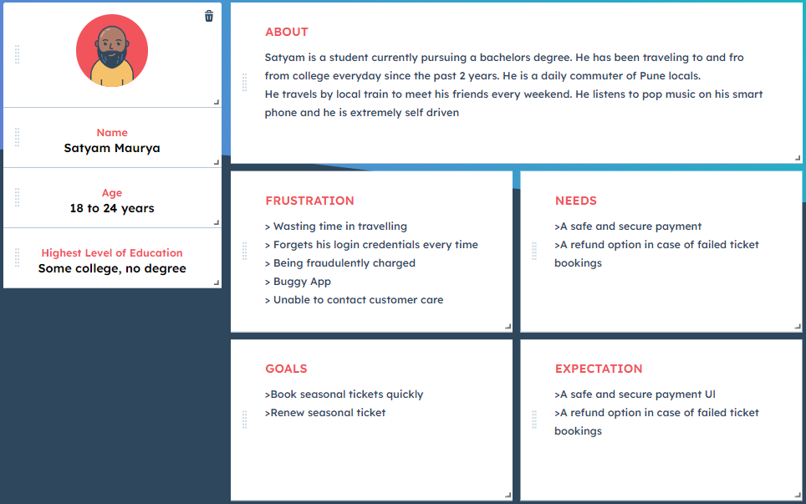
Persona 1

Slide 5
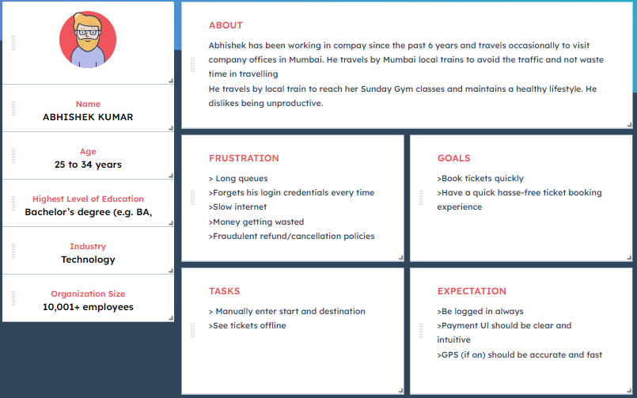
Persona 2

Slide 6
Scenario 1
Satyam is busy getting ready for college, when he gets a notification that his monthly (seasonal) pass is about to expire today. He quickly renews his pass and continues getting ready.
He attends college and his friends plan on heading back to his place for a group project. Since they were running late, they as Karan to book all their tickets from the our app. He books a ticket for all of his friends and shares with them.
TASKS
Being notified when tickets expiring
Renew pass
Successfully book tickets
Book multiple tickets
Share Tickets

Slide 7
Scenario 2
Abhishek lives in Hadapsar. Hir client is in Shivaji Nagar, Pune. he has to book a train ticket for her journey from Hadapsar to Shivaji Nagar. He has time to spare so she decides to book a ticket from her house. He enters the source and drop platform details. He chooses the route that is most convenient for him. He continues the booking and is asked to make a payment. He selects a card from the list of cards that were added by him previously. He successfully books her ticket
TASKS
Book Tickets away from station
Manually enter source/drop platform
Choose Convenient route
Make payment using added Card
Successfully book boke

Slide 8
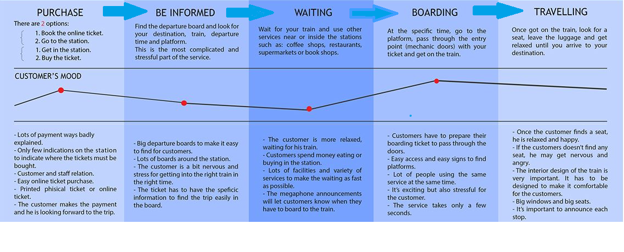
Journey Map

Slide 9
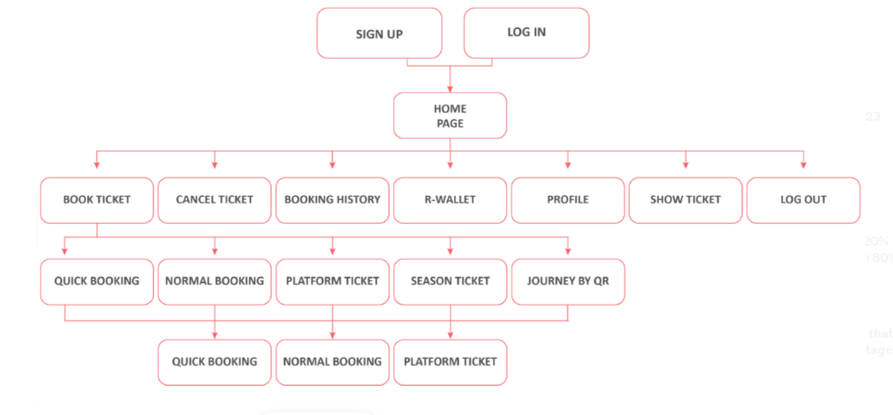
Before Flow Chart

Slide 10
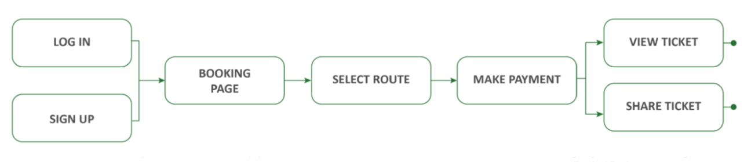
After Flow Chart

Slide 11
Conclusion
This project has provided a great learning experience like none other.
Our designing skills are major players when defining the way a product solves a problem or create a better user experience.
Designing UI, is a never ending process. It is constantly evolving and getting better as we understand our users better.

Slide 12
Reference
https://uxplanet.org/designing-a-better-ui-for-irctc-ios-app-c05444929da3.
https://www.designrush.com/best-designs/apps/israel-railways-app-design
https://uxdesign.cc/ux-ui-case-study-uts-app-indian-railways-6f89216ac699

Slide 13
THANK YOU

